Slide 1

Project Template Large Language Models in Production May 2026 (ST Engineering)
Facilitator: A/P TAN Wee Kek :: Email: distwk@nus.edu.sg
© National University of Singapore. All Rights Reserved.

Slide 2
<Project Title>
Group Number: XX
Group Members:
XXX
XXX
XXX
XXX
XXX

Slide 3
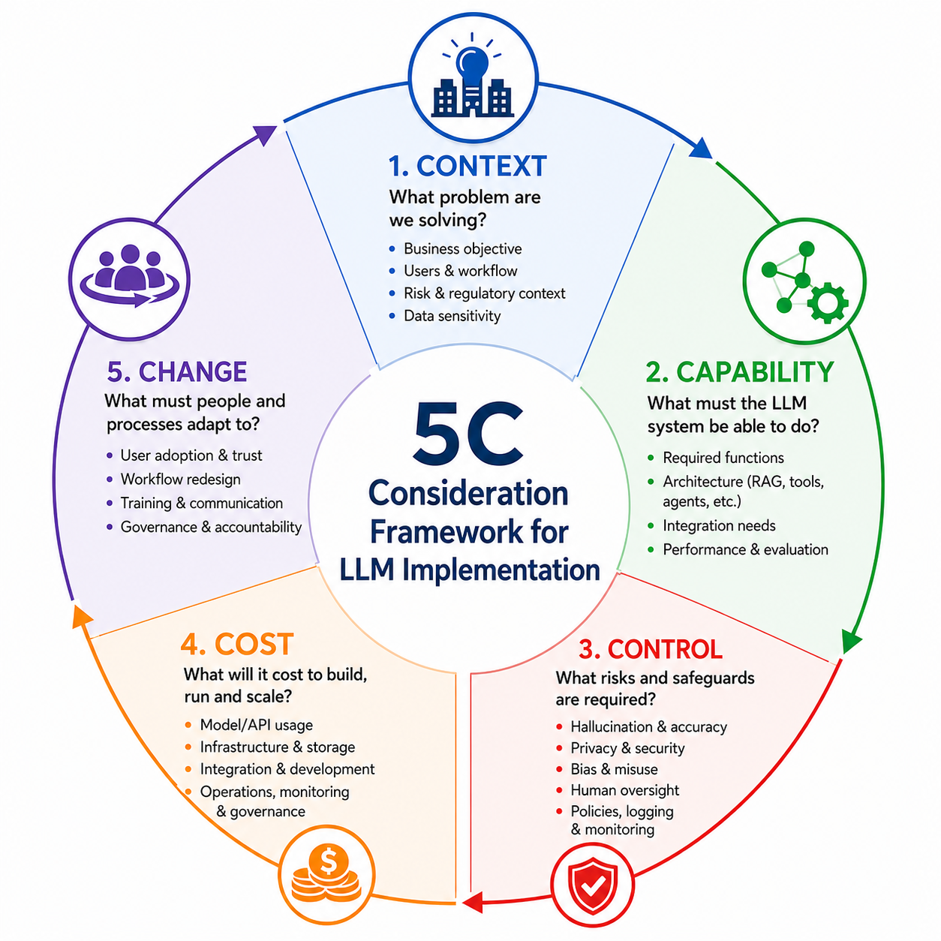
The 5C Consideration Framework
The 5Cs provide a quick but structured way to evaluate LLM implementation readiness.

Slide 4
5C Assessment Checklist
Dimension | Essential Question | What to Check
Context | Is the use case clearly defined? | Business value, users, workflow, risk level
Capability | Can the system perform the task? | Required functions, architecture, evaluation
Control | Can risks be managed? | Privacy, security, hallucination, human oversight
Cost | Is it economically sustainable? | Build cost, run cost, scaling cost
Change | Will people adopt it properly? | Training, workflow redesign, accountability
Suggested decision logic:
High value + manageable risk + sustainable cost → Proceed
Unclear value + high risk + high cost → Rethink
Useful but risky → Pilot with strong controls and human oversight

Slide 5
C1: Context
XXX

Slide 6
C2: Capability
XXX

Slide 7
C3: Control
XXX

Slide 8
C4: Cost
XXX

Slide 9
C5: Change
XXX

